Slide 1
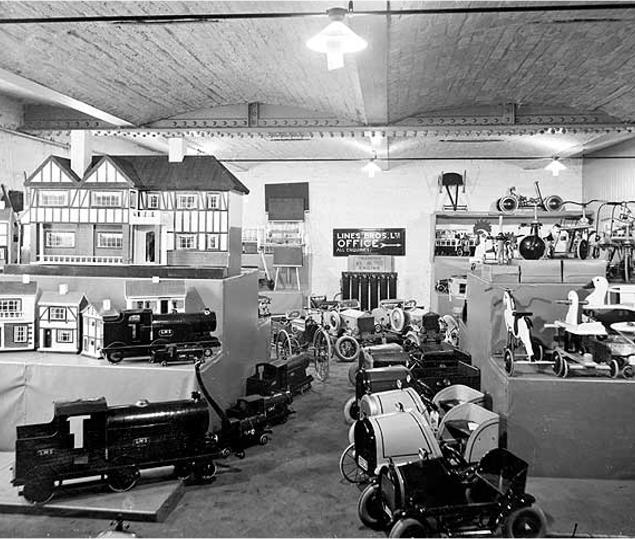
What sort of toys did my great grandparents play with?
What sort of toys did my great grandparents play with?

Slide 2
What sort of toys did my great grandparents play with?
Key Stage 1: History
Learning Aims and Outcomes
Describe the characteristics of old toys
Identify similarities and differences
Infer information from a picture or photograph
Speak about toys that belonged to their grandparents/great-grandparents
This activity relates to the ‘What sort of toys did my great grandparents play with?’ Teaching Activity

Slide 3
What sort of toys did children used to play with?
Look carefully at the photograph of a Toy Shop on the next slide.
It was taken in 1927.
How many different types of toy can you see?

Slide 4
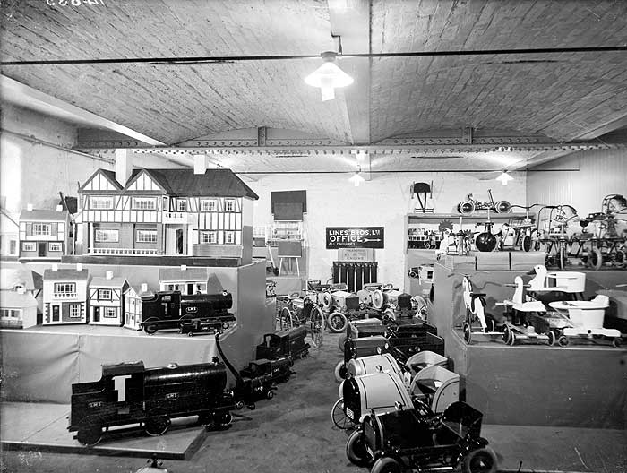
What sort of toys did children used to play with?
Look carefully at the photograph of a Toy Shop. It was taken in 1927.
How many different types of toy can you see?

Slide 5


What toys did you find?
Blackboards
Dolls houses
Ride-on ducks
Ride-on trains
Ride-in cars
How is it different from a toy shop today?

Slide 6
Which toy would you most like to play with?
Draw a picture of yourself playing with that toy
Notes:
Find more teaching resources at: HistoricEngland.org.uk/Education

