Slide 1
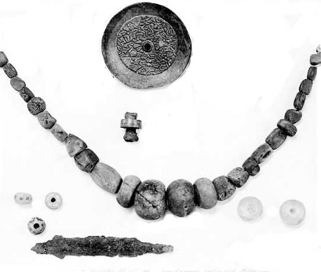
What can archaeological evidence tell us about the Anglo-Saxons?
What can archaeological evidence tell us about the Anglo-Saxons?
Notes:
Image: Source: Historic England Archive Ref: CC50/00361 Date: 1890

Slide 2
What can archaeological evidence tell us about the Anglo-Saxons? 1
Key Stage 2: History
Learning Aims and Outcomes
To make inferences from archaeological evidence
To understand that the Anglo-Saxons lived a long time ago
To learn what we can and can not discover from archaeological evidence
To select distinctive features of the Anglo-Saxons

Slide 3



Anglo-Saxons
We can find out lots about the Anglo-Saxons by looking at archaeological evidence.
It's an archaeologist’s job to look at evidence, such as artefacts and buildings, from the past and to try and interpret them!
Consider
Could YOU be an archaeologist?

Slide 4


Step 1: Learn to speak ‘archaeologist’
To be an archaeologist you need to learn some new words…
Archaeology: The study of the lives of people in the past
Evidence: Information to support an idea/interpretation
Artefact: Any object made or changed by people
Interpret: To try and explain what something means
Excavate: To dig up and record archaeological remains

Slide 5
Step 2: Rot or Not?
What do you think would survive for 1000 years?
Food
Metal
Wood
Pottery
Glass
Leather
Fabric
Bones

Slide 6




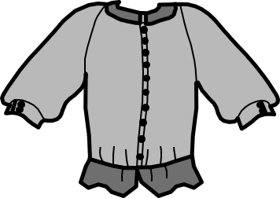




Rot or Not – Cut out and stick the artefacts on the table
Rot | Not
Food
Pottery
Fabric
Metal
Wood
Bones
Glass
Leather

Slide 7
Step 2: Rot or Not? ANSWERS
ROT | NOT
Pottery
Metal
Food
Wood
Fabric
Leather
Glass
Bones

Slide 8

Rot or Not? Extension Activity: The ‘Rubbish Bag Game’
All archaeologists are detectives – for the Rubbish Bag Game select clean, safe pieces of ‘rubbish’ and place them in a black bin bag.
Pupils take it in turns to pick out a piece of ‘rubbish’, then the whole class have to work out what it is and who might have used it/thrown it away.
Deliberately choose bits of ‘rubbish’ so that pupils can build up a picture of the person/family that threw them away.
Analyse
Notes:
Take the Rot or Not theme a step further and play the Rubbish Bag Game

Slide 9

Rot or Not? Extension Activity: The ‘Rubbish Bag Game’ 1
Once the rubbish bag is empty ask pupils to think about which items would survive being buried in the ground for 1000s of years – would it Rot or Not?
Any items that they don’t think would survive get taken away, so you now have a much smaller pile of ‘rubbish’.
Pupils then reassess the evidence and start to understand that archaeologists can only work with what they’ve got – there’s a lot that they don’t know, but have to make ‘educated guesses’ about.
Infer
Notes:
Take the Rot or Not theme a step further and play the Rubbish Bag Game

Slide 10


Step 3: Examine EVIDENCE from the past
Examine
Archaeologists EXCAVATE (dig up) archaeological sites to discover and record daily life in ancient times
The photograph shows ARTEFACTS from an EXCAVATION in Wheatley in Oxfordshire that took place in 1890.
Can you work out what any of the ARTEFACTS are?
Notes:
Image: Source: Historic England Archive Ref: CC50/00361 Date: 1890

Slide 11
Can you label the artefacts?
Notes:
Image: Source: Historic England Archive Ref: CC50/00361 Date: 1890

Slide 12



ANSWERS: How did you do?
Brooch
(Metal)
Necklace
(Pottery beads)
Ring (Metal)
Beads
(Glass)
Beads
(Glass)
Finger bone!
Knife blade
(Metal)
Notes:
Image: Source: Historic England Archive Ref: CC50/00361 Date: 1890

Slide 13

Step 4: INTERPRET EVIDENCE from the past 1
Artefacts need to be interpreted.
Archaeologists often do this by creating a RECONSTRUCTION DRAWING.
Use your evidence to draw what you think the Anglo-Saxon owner would have looked like!
Draw
Remember to think about…

Slide 14





Step 4: INTERPRET EVIDENCE from the past 2
What you know
What you need to decide
Hypothesize
Wore a necklace
Wore a brooch
Wore a ring
Wore glass beads
Carried a small knife
Man, woman or child?
What type of clothes?
What colour of clothes?
What hair style?
What else might have rotted away? (Leather bag etc.)
Remember: Anglo-Saxons mainly had wool or leather to make clothes
Remember: Anglo-Saxons only had natural dyes

Slide 15
My Anglo-Saxon person

Slide 16
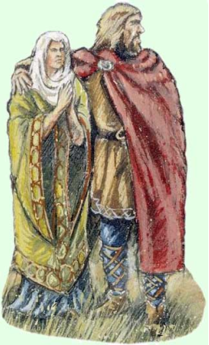

Need some inspiration?
Reveal the picture.
It shows another archaeologist’s reconstruction drawing of what Anglo-Saxon people might have looked like!
Notes:
Find more teaching resources at:
HistoricEngland.org.uk/Education

Slide 17


Step 4: INTERPRET EVIDENCE from the past 3 3
Remember!
All of your drawings - no matter how different - are valid archaeological interpretations, so long as you used the evidence to justify what you drew and why!
Now look at a friend’s drawing - does it look the same as or different from yours?
Justify

Slide 18



Step 5: Discuss your choices1
Pairs
Archaeologists don’t always agree!
In pairs or groups discuss your choices.
Can you justify your answers?
As a whole class hold a debate to discuss different INTERPRETATIONS, then vote on which reconstruction drawing you like the best.
Speak
Listen
Justify
Class discussion

Slide 19
Teachers’ Notes – The Anglo-Saxons in Britain 1 1
The ‘Anglo-Saxons’ began as different groups of people who lived along the northern coast of mainland Europe. In the years 400-700AD Britain was invaded and settled by the Angles (from Germany), Saxons (from Germany), Jutes (from Denmark) and many other peoples from northern Germany and southern Scandinavia
The Angles, Saxons and others sailed to Britain in wooden ships. Although many had sails, they were more like large rowing boats
Some of the first Anglo-Saxons to arrive in Britain may have been paid to fight for the Roman Army
The Anglo-Saxons wrote a book called the Anglo-Saxon Chronicle (commissioned by Alfred the Great). A lot of what we know about the Anglo-Saxons comes from this book. It was written c. 892
England was divided into a series of Kingdoms, each with its own rulers. The main kingdoms were Wessex, Mercia, Northumbria and East Anglia
Much of their settlement may have been peaceful, but the Anglo-Saxon Chronicle also tells of some ferocious battles. In 491 the Anglo-Saxons attacked the Britons living in the Roman fort at Pevensey, Sussex. The Chronicle states there was “not even one Briton left”
The ‘Anglo-Saxons’ began as different groups of people who lived along the northern coast of mainland Europe. In the years 400-700AD Britain was invaded and settled by the Angles (from Germany), Saxons (from Germany), Jutes (from Denmark) and many other peoples from northern Germany and southern Scandinavia
Notes:
The information below is a brief history of the Anglo-Saxons in Britain

Slide 20
Teachers’ Notes – The Anglo-Saxons in Britain 2 1
They used both cremation and burial for their dead. Graves and the objects in them give archaeologists vital clues about how they lived and what they wore. Skeletons found show that many died before they were 25 and very few lived to older than 40
They worshiped many different gods such Woden (Chief god), Frig (Goddess of growth), Thunor (God of sky and thunder) and Tiw (God of war)
Missionaries were sent from Rome to try and convert the Anglo-Saxons to Christianity. Most resisted but some, such as King Aethelbert of Kent, converted and Aethelbert went on to found Canterbury Cathedral
They wrote using letters called runes
They lived in small tribal groups/Kingdoms
Every person in Anglo-Saxon society had a value in money – known as Wergild. A noble had a high Wergild value and a peasant a low value, slaves even lower! If a person was killed or injured, they or their family could be given the right amount of money (compensation) - unless they were killed or injured whilst stealing!!
Archaeological evidence tells us that they ate beef, mutton, pork, wheat, barley, oats and peas as their main foods and they made and used wooden bowls and pottery bowls/objects. They also had their own coins/currency
In 731 an Anglo-Saxon monk known as the ‘Venerable Bede’, wrote a book called ‘Ecclesiastical History of the English Peoples’
Notes:
The information below is a brief history of the Anglo-Saxons in Britain

