Slide 1
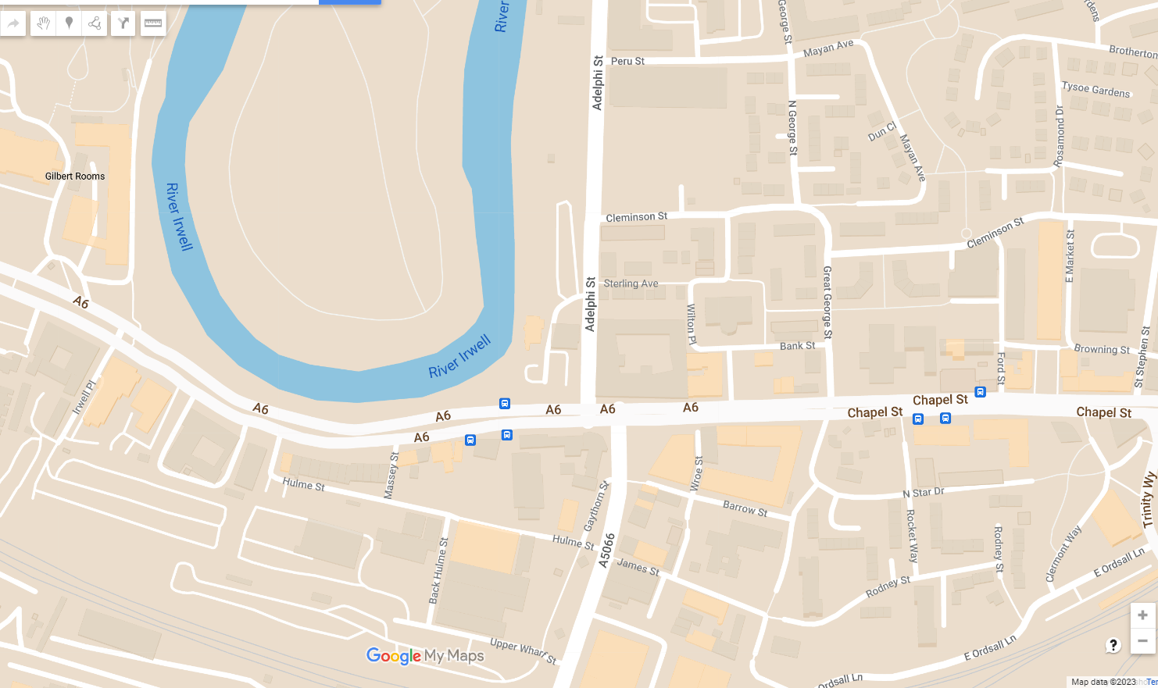
KS2 Route Map
13
8
7
12
5
6
3
9
4
11
10
2
 | Islington Mill |  | St Philip's Church |  | River View
 | Islington Park |  | Encombe Place |  | Peel Park
 | Bexley Square |  | Cleminson Street |  | Salford Museum
 | Cathedral |  | Salford Royal
 | St Philip's Square |  | Transport House
1
6
11
2
7
12
3
8
13
1
4
9
5
10
Notes:
View the stops named on this route online on the StoryMap: https://storymaps.arcgis.com/stories/02c8288dd376403c80f012dd5fe84cec

